Slide 1

Deep Learning and Generative AI (MSCDAD_A)
Comprehensive Evaluation of Job satisfaction using
Deep Learning Approaches
Devanshu Singh

Slide 2
Introduction
When evaluating job opportunities, what are the most effective ways to assess whether a company is a good fit and maintains a positive work environment?
An AI-driven solution leveraging deep learning to predict employee satisfaction scores based on company reviews, offering fast, transparent, and reliable insights with built-in interpretability for informed decision-making.

Slide 3
About Models
Bi-LSTM
Uses a BiLSTM with an attention mechanism to focus on important words in reviews (pros, cons and headlines integrating with overall rating)
Integrates embeddings for job title, location, and structured features for a multi-input architecture.
Designed for sequence learning and interpretability using token-level attention.
DistilBERT
Utilizes a pretrained advanced DistilBERT transformer to generate context-aware text embeddings.
Fine-tuned on review texts to capture semantic nuances and improve classification performance.
Efficient and powerful for handling large-scale natural language inputs.

Slide 4
So basically,
So this is basically sentiment analysis for Glassdoor job reviews, right?
NO! This is not just any sentiment analysis, but it helps measure the intensity of sentiments on the scale of 1 - 5 while providing interpretability and insights generated from it.

Slide 5
Process Flow
DistilBERT + SHAP
• Text Preprocessing and Tokenization: Used DistilBertTokenizerFast to tokenize reviews (headlines, pros, cons) with attention masks and dynamic padding for compatibility with transformer models.
• Structured Feature Engineering: Selected top correlated structured features, handled missing values using median imputation, normalized data, and converted overall_ratings into categorical classes (0–4)
1. Prediction
• Data Splitting and Preparation: Converted tensors to NumPy arrays, split into train-test-validation sets, and built a custom BertFusionModel to merge transformer and structured inputs.
• Model Compilation and Training: Applied class weights, early stopping, and learning rate reduction; fine-tuned DistilBERT by freezing initial layers and unfreezing later layers.
• Model Evaluation: Displayed classification report, model summary, and plotted accuracy/loss curves, confusion matrix, and per-class accuracy for performance assessment.
2. Explainibility
• Interpretability with SHAP: Used SHAP Explainer for both text and structured inputs, visualized token-level force plots, and generated combined SHAP bar graphs and contribution summaries.
3. Insights
• Insights Generation:
Visualized trends like satisfaction by location, and before-after SHAP word usage to derive meaningful insights from the model’s predictions.

Slide 6
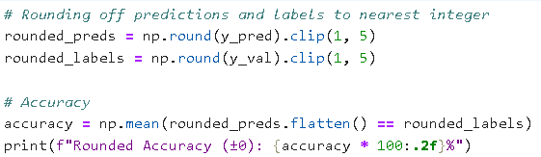
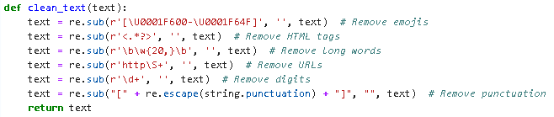
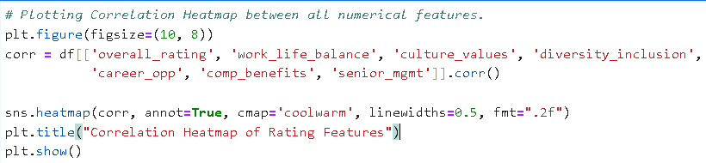
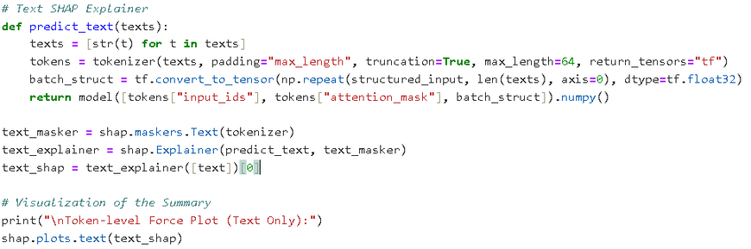
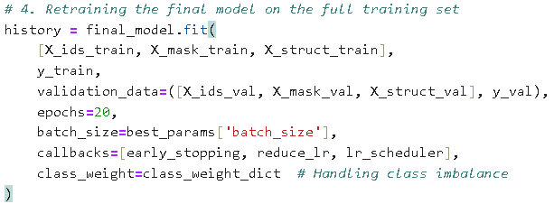
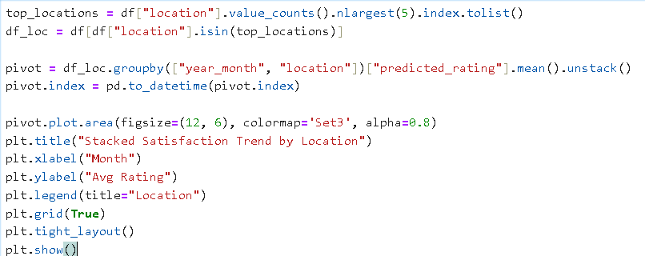
Important Code Snippets
Fig 4. Evaluation
Fig 1. Data preprocessing
Fig 2. Exploratory Data Analysis
Fig 5. Explainibility
Fig 3. Model Application
Fig 6. Insights

Slide 7
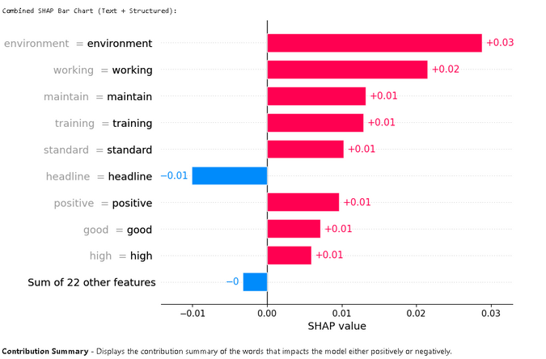
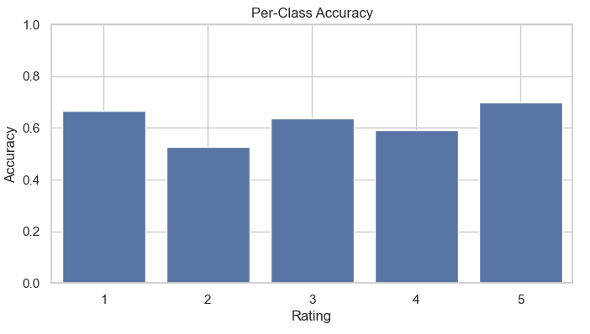
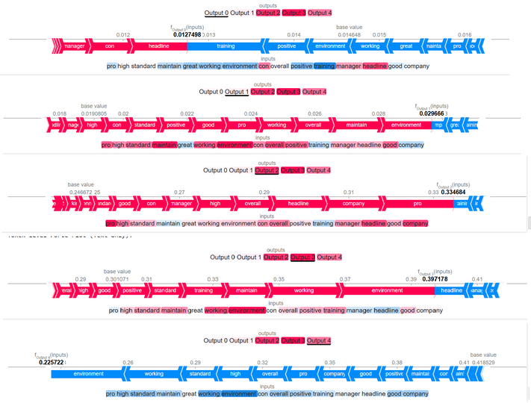
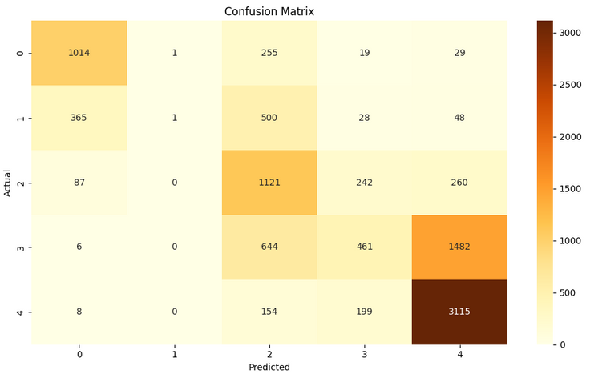
Evaluation
Evaluation details for the DistilBERT
Showing all the evaluation visualization for DistilBERT model including confusion matrix, per-class accuracy, SHAP force plot and SHAP combined bar chart.

Slide 8
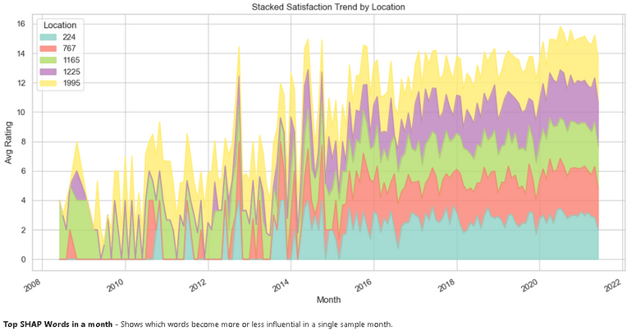
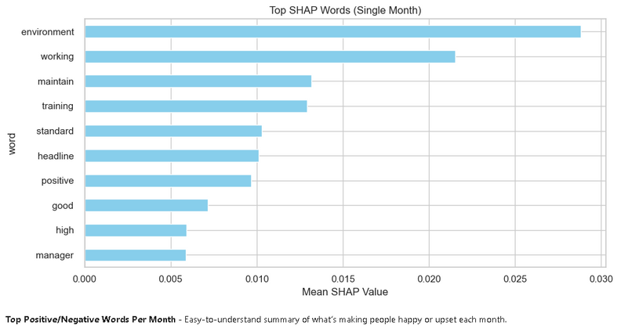
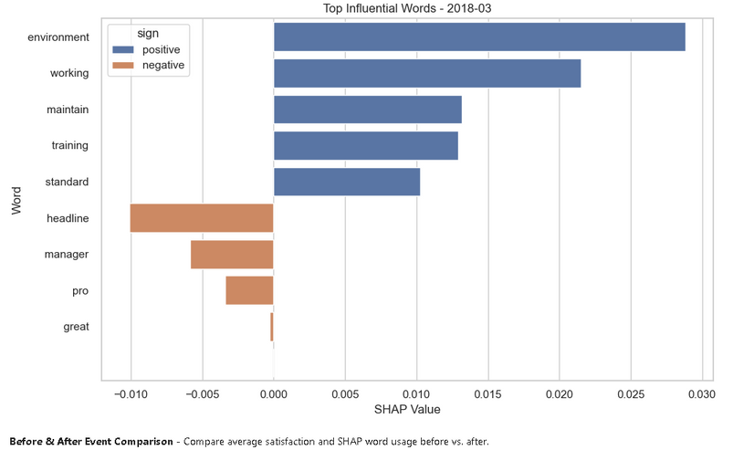
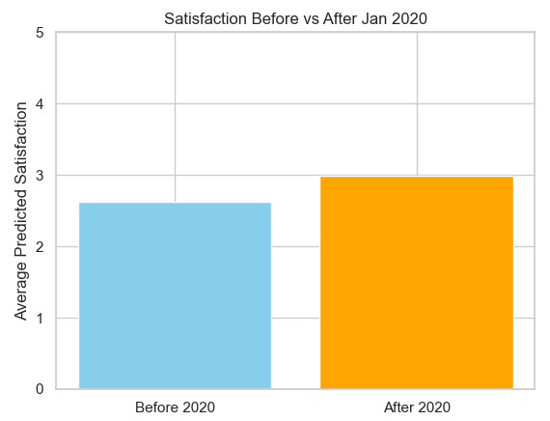
Insights
Insight generated after model application
Insights generated and displayed through visualizations on various aspects.

Slide 9
Thank you!

